Slide 1

DEVOPS STARTER PACK:
11 EASY MINI PROJECTS
A Simple, Hands-On Guide to Cloud and Automation
Omar Tokal

Slide 2

THE CRUCIAL LAB RULES
Rule 1: No Copy-Paste. Do not use AI to write code for you. Type every single letter yourself to learn the syntax!
Rule 2: Watch Your Spaces. YAML and Terraform are very sensitive to spacing. Spacing builds muscle memory.
Rule 3: Read Error Messages. When code fails, read the terminal carefully. Most errors tell you exactly how to fix them!

Slide 3
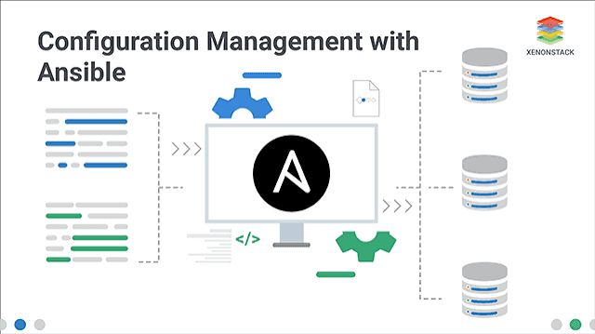


PROJECT 1: SYSTEM SETUP
The Story
You have a brand new server with nothing on it. Before you install apps, you must update the system and install basic tools.
Your Goal:
Create a simple Ansible script to update the system and install handy tools like curl and git.

Slide 4


P1: TASK IMPLEMENTATION
Easy Steps
Create a file called main.yml. Write two simple tasks: one to update the cache, and one to install packages.
--- - name: Update system cache apt: update_cache: yes when: ansible_os_family == "Debian" - name: Install utility tools apt: name: [curl, git, htop, tree] state: present when: ansible_os_family == "Debian"

Slide 5
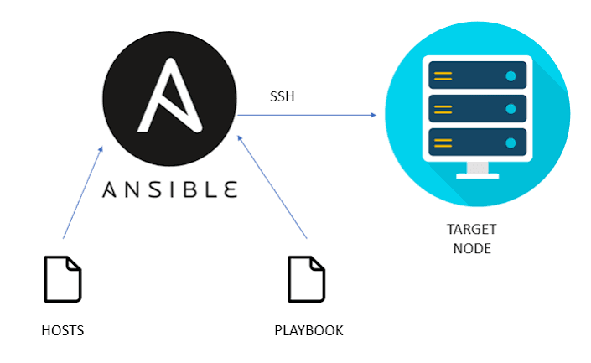
PROJECT 2: RUN A WEBSITE
The Story
Your team needs a basic placeholder website up and running. Instead of doing it manually, write a tool to do it instantly.
Your Goal:
Write an Ansible script to install the Nginx web server and copy a welcome page online.

Slide 6

P2: WEB SERVER TASKS
Easy Steps
1. Make a simple web page named index.html.
--- - name: Install Nginx server apt: name: nginx state: present - name: Copy welcome page copy: src: index.html dest: /var/www/html/index.html - name: Start Nginx web server service: name: nginx state: started enabled: yes
2. Create a script to install Nginx, copy the page into place, and make sure the server starts.

Slide 7


PROJECT 3: USER ACCOUNTS
The Story
New programmers are joining your team. To keep the server secure, you must create a separate user account and group for them.
Your Goal:
Build an Ansible script to create a secure group and add a user named devuser safely.

Slide 8


P3: USER MANAGEMENT
Easy Steps
1. Write a script to create a user group called developers.
--- - name: Create developer group group: name: developers state: present - name: Create user devuser user: name: devuser shell: /bin/bash groups: developers append: yes state: present
2. Create the user devuser and place them into that developers group.

Slide 9
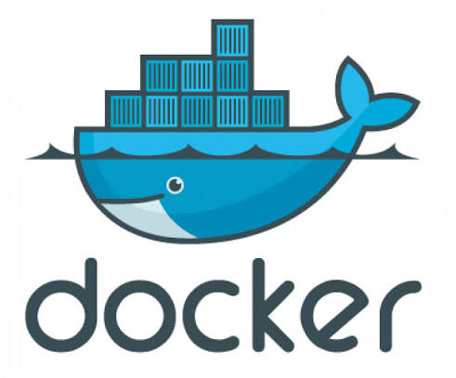
PROJECT 4: INSTALL DOCKER
The Story
Your team wants to run apps inside simple packages called containers. You must install the Docker engine on the server to do this.
Your Goal:
Create an Ansible script to download Docker and allow devuser to run containers without typing sudo.

Slide 10
P4: INSTALL TASKS
Easy Steps
1. Write a task to install docker.io.
2. Ensure Docker starts automatically.
--- - name: Install Docker package apt: name: docker.io state: present - name: Start Docker service service: name: docker state: started enabled: yes - name: Let devuser run Docker user: name: devuser groups: docker append: yes
3. Add the user devuser to the secure docker group.
After running this, the user must log out and back in to apply the group change!

Slide 11
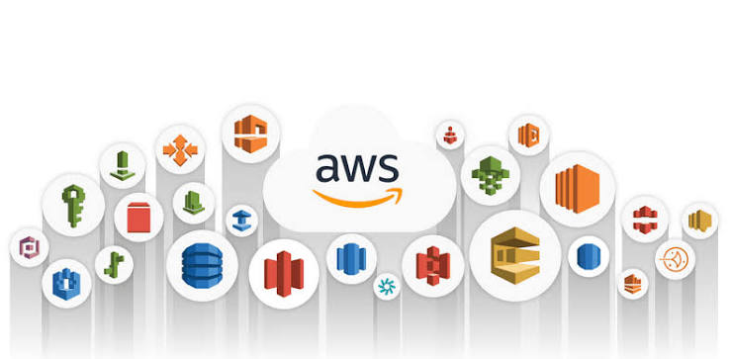
PROJECT 5: EASY CLOUD COMPUTE
The Story
You want a virtual server in AWS. Instead of manually clicking buttons on the Amazon website, write a blueprint to deploy it automatically.
Your Goal:
Use Terraform to write a single config file that launches a tiny server with a web server installed.

Slide 12

P5: CLOUD INSTANCE CODE
Easy Steps
provider "aws" { region = "us-east-1" } resource "aws_security_group" "web_sg" { name = "easy-web-sg" ingress { from_port = 80; to_port = 80; protocol = "tcp"; cidr_blocks = ["0.0.0.0/0"] } egress { from_port = 0; to_port = 0; protocol = "-1"; cidr_blocks = ["0.0.0.0/0"] } } resource "aws_instance" "server" { ami = "ami-0c7217cdde317cfec" instance_type = "t2.micro" vpc_security_group_ids = [aws_security_group.web_sg.id] user_data = "#!/bin/bash\nsudo apt-get update -y\nsudo apt-get install apache2 -y\necho ' ' | sudo tee /var/www/html/index.html" }
1. Set the region to us-east-1.
2. Create security rules to allow web traffic (port 80).
3. Ask AWS to launch a simple t2.micro instance.
Outbound rules are required! If outbound traffic is blocked, AWS cannot download Apache.

Slide 13
PROJECT 6: CHEAP S3 WEB HOST
The Story
You have a personal page you want to show online. A standard virtual server is expensive. Let's host it on S3 storage instead for pennies a month!
Your Goal:
Write simple Terraform code to create an AWS S3 bucket, configure website hosting, and make it viewable to everyone.

Slide 14

P6: CLOUD S3 SETUP
Easy Steps
1. Create an S3 Bucket. Make sure the name is unique worldwide.
resource "aws_s3_bucket" "web_bucket" { bucket = "easy-devops-portfolio-101" } resource "aws_s3_bucket_website_configuration" "site" { bucket = aws_s3_bucket.web_bucket.id index_document { suffix = "index.html" } } resource "aws_s3_bucket_public_access_block" "block" { bucket = aws_s3_bucket.web_bucket.id block_public_acls = false block_public_policy = false } resource "aws_s3_bucket_policy" "read_policy" { bucket = aws_s3_bucket.web_bucket.id policy = jsonencode({ Version = "2012-10-17" Statement = [{ Effect = "Allow", Principal = "*", Action = "s3:GetObject", Resource = "${aws_s3_bucket.web_bucket.arn}/*" }] }) }
2. Disable the default blocks to allow public access.
3. Write a simple permission rule to allow web reading.
S3 names cannot contain spaces or match any other existing bucket name in the world!

Slide 15

PROJECT 7: SIMPLE SECURE VPC
The Story
By default, cloud networks are shared and open. To protect your apps, you need a custom private sandbox network (VPC) that you control.
Your Goal:
Create a secure network sandbox with your own subnets, routing, and access to the internet.using terraform.

Slide 16

P7: CUSTOM CLOUD NETWORK
Easy steps terraform state
1. Define a private IP range (VPC).
2. Create a subnet block for servers.
resource "aws_vpc" "my_vpc" { cidr_block = "10.0.0.0/16" } resource "aws_subnet" "subnet" { vpc_id = aws_vpc.my_vpc.id cidr_block = "10.0.1.0/24" map_public_ip_on_launch = true } resource "aws_internet_gateway" "igw" { vpc_id = aws_vpc.my_vpc.id } resource "aws_route_table" "rt" { vpc_id = aws_vpc.my_vpc.id route { cidr_block = "0.0.0.0/0"; gateway_id = aws_internet_gateway.igw.id } } resource "aws_route_table_association" "a" { subnet_id = aws_subnet.subnet.id route_table_id = aws_route_table.rt.id }
3. Create an Internet Gateway to let traffic out.
4. Connect the gateway to your route table.

Slide 17



PROJECT 8: RELIABLE WEB SERVERS
The Story
If you run only one web server, it will eventually go offline. To stay safe, you need two identical servers with a manager directing traffic.
Your Goal:
Launch two servers and put an AWS Application Load Balancer in front to share the traffic.

Slide 18

P8: SERVER CLUSTER SETUP
resource "aws_instance" "web_nodes" { count = 2 ami = "ami-0c7217cdde317cfec" instance_type = "t2.micro" user_data = "#!/bin/bash\napt-get update\napt-get install apache2 -y\necho ' ' > /var/www/html/index.html" } resource "aws_lb" "web_alb" { name = "easy-web-alb" load_balancer_type = "application" subnets = ["subnet-id-1", "subnet-id-2"] }
Easy Steps
1. Use the count = 2 loop to launch two copies of your web server.
2. Create a load balancer inside your subnets.
Server ${count.index+ 1}
Load balancers need at least two subnet zones to guarantee uptime during outages!

Slide 19

PROJECT 9: PACK YOUR WEBSITE
The Story
Running code on a system can be painful because setups vary. To solve this, you can bundle your website code and server inside a lightweight container.
Your Goal:
Write a single Dockerfile script that packages your custom index.html page and a small Nginx web server together.

Slide 20
P9: WEB CONTAINER SETUP
Easy Steps
1. Create a folder with your index.html page.
2. Extend Nginx Alpine (a super lightweight, tiny version of Nginx).
# Create a Docker blueprint FROM nginx:alpine # Copy local web files to standard Nginx path COPY index.html /usr/share/nginx/html/index.html # Expose web port EXPOSE 80
3. Copy your page inside, expose port 80, and run!
Alpine images are fantastic because they take up less than 10MB of disk space!

Slide 21

PROJECT 10: SIMPLE NODE API
The Story
Your team built a Node.js microservice app. It runs locally, but sometimes crashes on other computers due to missing software.
Your Goal:
Build a simple, standard Docker container layout to run Node.js apps anywhere instantly.

Slide 22
P10: NODE WEB CONTAINER
Easy Steps
1. Start with the Node.js base environment.
2. Copy dependency files (package.json) first and install them.
FROM node:20-alpine WORKDIR /usr/src/app # Speed up build by caching packages COPY package*.json ./ RUN npm install # Copy application files COPY . . EXPOSE 3000 CMD ["node", "index.js"]
3. Copy the rest of the application files and run.
Installing packages BEFORE copying your code lets Docker cache them, saving deployment time!

Slide 23
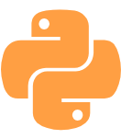
PROJECT 11: SYSTEM MONITOR
The Story
You wrote a Python script to monitor system statistics. To prevent installation errors on other hosts, containerize it.
Your Goal:
Run your script in a lightweight Python sandbox container to capture clean execution logs.

Slide 24

P11: PYTHON CONTAINER FILE
Easy Steps
1. Start with a light Python template image.
2. Add your monitoring script inside the container.
FROM python:3.11-alpine WORKDIR /app COPY monitor.py . # Stream print commands instantly ENV PYTHONUNBUFFERED=1 CMD ["python", "monitor.py"]
3. Force output logs to display instantly in your dashboard terminal.

Slide 25

PUBLISHING CODE TO GITHUB
Easy Steps
Now, save your Ansible and Terraform configuration files in a secure remote workspace.
# Initialize local repository folder git init # Tell git to ignore garbage and keys echo -e "*.retry\n.terraform/" > .gitignore # Save and upload to online repository git add . git commit -m "feat: cloud blueprints" git remote add origin https://github.com/USER/REPO.git git push -u origin main
This allows team members to download, share, and launch your cloud infrastructure instantly.

Slide 26
PUBLISHING TO DOCKER HUB
Easy Steps
# Login to your secure portal docker login # Tag container packages docker tag my-portfolio:v1 user/my-portfolio:latest docker tag node-quote-api:v1 user/node-quote-api:latest # Push packages into cloud storage docker push user/my-portfolio:latest docker push user/node-quote-api:latest
Now, distribute your custom web app containers to a registry so any server in the cloud can retrieve and run them.

